Slide 1
S&P Sectors: Weekend hugs vs. mid-week returns
Alex Burch • Martin Hrbac • Roderick Reynolds Rodney Kirkendoll • Serena Leung • Sunil Joshi

Slide 2
DATA EXPLORATION

Slide 3



project IDEA exploration
Potential Alternatives
Cannabis
Restaurant Ratings
Healthcare
Elections & Voting
Indexed Stock Trading
Idea with Findings Not Readily Available On-Line
Clean Data

Slide 4

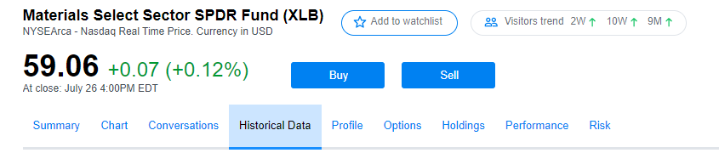
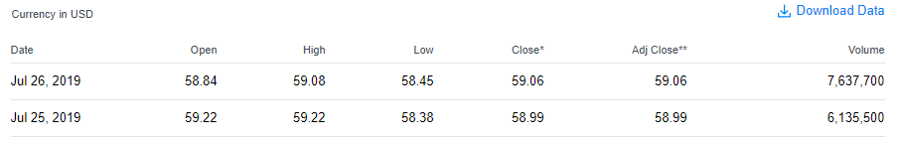
Stock themed consensus
Indexed Stock Trading Subset
S&P 500 – Most Traded Index in the U.S. (SPY)
S&P 500 Comprised of 11 Sectors by Ticker
Sector Exchange Traded Fund (ETF) Pie
http://www.sectorspdr.com/sectorspdr/
Clean Ticker Data from Yahoo Finance
https://finance.yahoo.com/

Slide 5
Stock themed Consensus
Holidays and Weekends for Consideration
U.S. Holidays, Federal Holiday Closures, Friday to Monday Effect
Holding Periods Cascaded from Fri to Mon Intrigue
Weekend Hug: Thurs 4pm Close – following Mon 4pm Close
Mid-Week: Mon 4pm Close – following Thurs 4pm Close
Duration Tied to Rise in Electronic Trading (2001)
Trades Routed to More than 1 Institution
Trading in Pennies
Automated Matching of Buy and Sell Orders

Slide 6
Sample Set duration
Ticker | Sector Name | Duration of Interest
XLB | Materials | Mon 1/3/2000 – Fri 7/19/2019
XLC | Communication Services | Tues 6/19/2018 – Fri 7/19/2019
XLE | Energy | Mon 1/3/2000 – Fri 7/19/2019
XLF | Financials | Mon 1/3/2000 – Fri 7/19/2019
XLI | Industrials | Mon 1/3/2000 – Fri 7/19/2019
XLK | Technology | Mon 1/3/2000 – Fri 7/19/2019
XLP | Consumer Staples | Mon 1/3/2000 – Fri 7/19/2019
XLRE | Real Estate | Mon 10/8/2015 – Fri 7/19/2019
XLU | Utilities | Mon 1/3/2000 – Fri 7/19/2019
XLV | Health Care | Mon 1/3/2000 – Fri 7/19/2019
XLY | Consumer Discretionary | Mon 1/3/2000 – Fri 7/19/2019

Slide 7
Hypotheses (plural)

Slide 8
Hypothesis #1 – S&P sectors AS A GROUP
Hypothesis #1: Considering the 11 S&P sectors as a group, buying Monday’s close and selling on Thursday’s close (Mid-Week) achieves a 0.25% higher average return than buying Thursday’s close and selling on Monday’s close (Weekend Hug).
Null Hypothesis (Ho): There is no relationship between average returns and buying and selling over these two periods of interest from 1/3/2000 through 7/19/2019.
Holding Periods of Interest
Weekend Hug: Thurs 4pm Close – following Mon 4pm Close
Mid-Week: Mon 4pm Close – following Thurs 4pm Close

Slide 9
Hypothesis #2 – S&P sectors individual tickers
Hypothesis #2: Considering the 11 S&P sectors individually, buying Monday’s close and selling on Thursday’s close (Mid-Week) achieves a 0.25% higher average return than buying Thursday’s close and selling on Monday’s close (Weekend Hug).
Null Hypothesis (Ho): There is no relationship between average returns and buying and selling over these two periods of interest from 1/3/2000 through 7/19/2019.
Holding Periods of Interest
Weekend Hug: Thurs 4pm Close – following Mon 4pm Close
Mid-Week: Mon 4pm Close – following Thurs 4pm Close

Slide 10
Exploratory data analysis

Slide 11
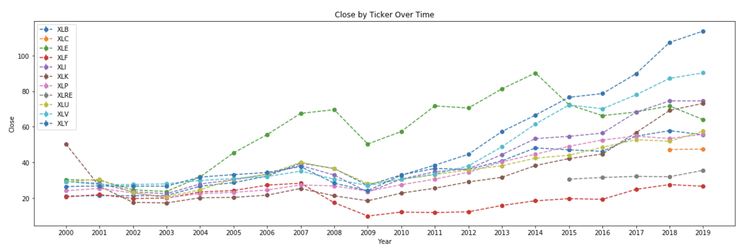
Close by Ticker over time
While the Energy sector had historically high average % returns, it has recently been surpassed by Consumer Discretionary, Healthcare, Industrials, and Technology.

Slide 12
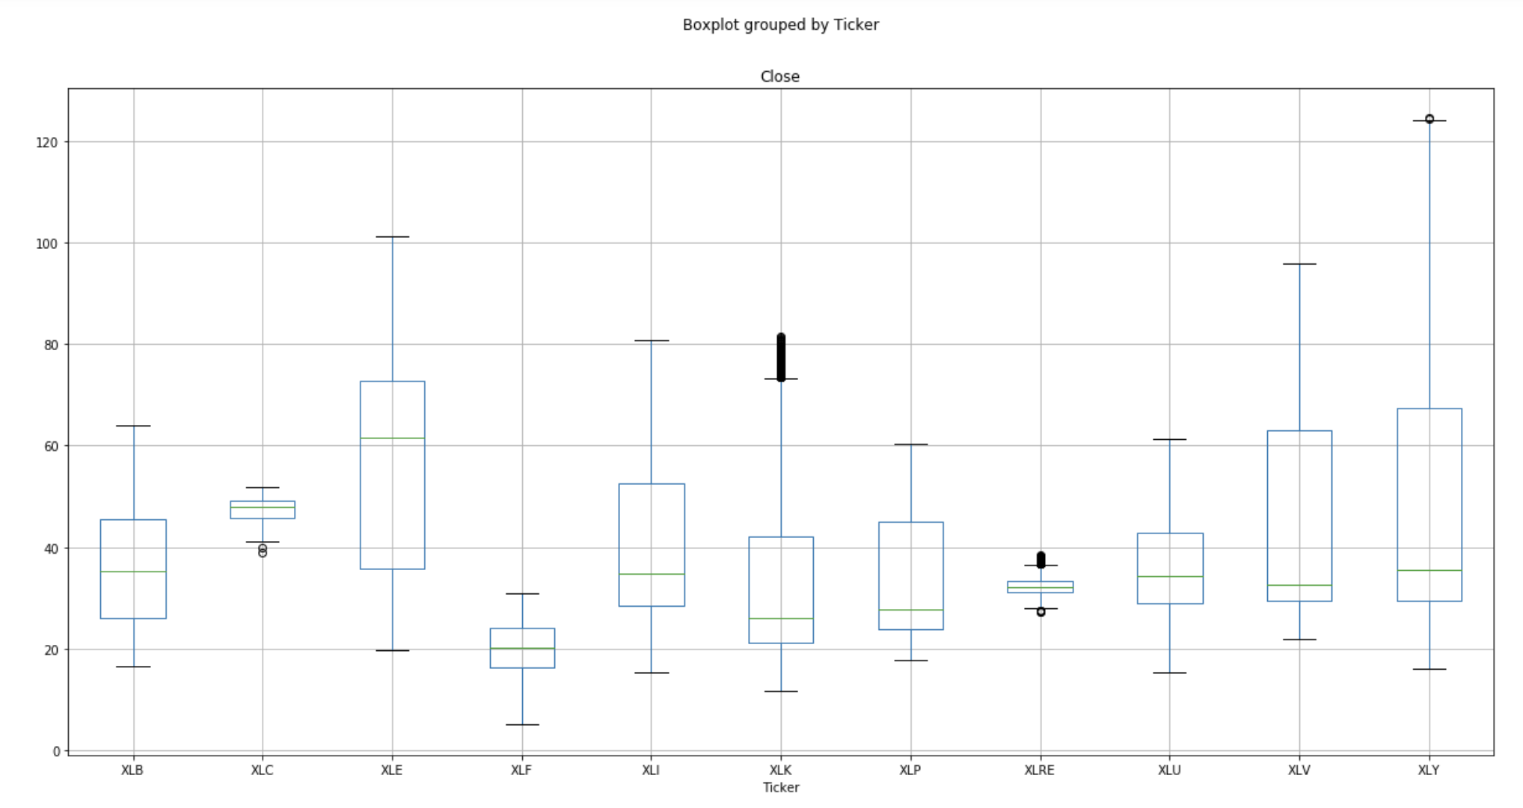
Boxplot by Ticker
The median closing price is highest for the Energy sector. Telecom and the Real Estate sector closes have a very tight spread. The Energy, Healthcare, and Consumer Discretionary sectors have higher variance in closing price.
Materials Sector
Telecomm. Svcs. Sector
Energy Sector
Financial Sector
Industrials Sector
Technology Sector
Consumer Staples Sector
Real Estate Sector
Utilities Sector
Healthcare Sector
Consumer Discretionary Sector

Slide 13
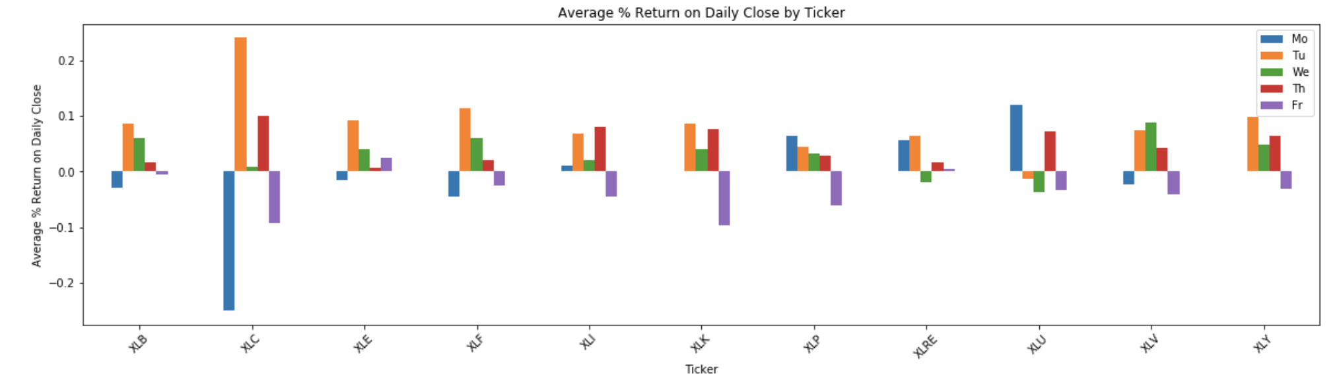
Daily Close % change
Tuesdays average % returns (Monday’s close to Tuesday’s close) spike for most tickers.
Materials Sector
Telecomm. Svcs. Sector
Energy Sector
Financial Sector
Industrials Sector
Technology Sector
Consumer Staples Sector
Real Estate Sector
Utilities Sector
Healthcare Sector
Consumer Discretionary Sector

Slide 14
data analysis

Slide 15

data Smear Consideration
The stock market was closed or outside duration about 20% of the time on Mondays and Thursdays which impacted the holding periods. Using un-smeared data was chosen.
Ticker | Data Smeared P-values | Un-Smeared Data P-values
XLB | 0.098 | 0.119
XLC | 0.093 | 0.023
XLE | 0.414 | 0.214
XLF | 0.057 | 0.239
XLI | 0.053 | 0.098
XLK | 0.012 | 0.031
XLP | 0.243 | 0.163
XLRE | 0.833 | 0.660
XLU | 0.236 | 0.424
XLV | 0.002 | 0.007
XLY | 0.033 | 0.031

Slide 16

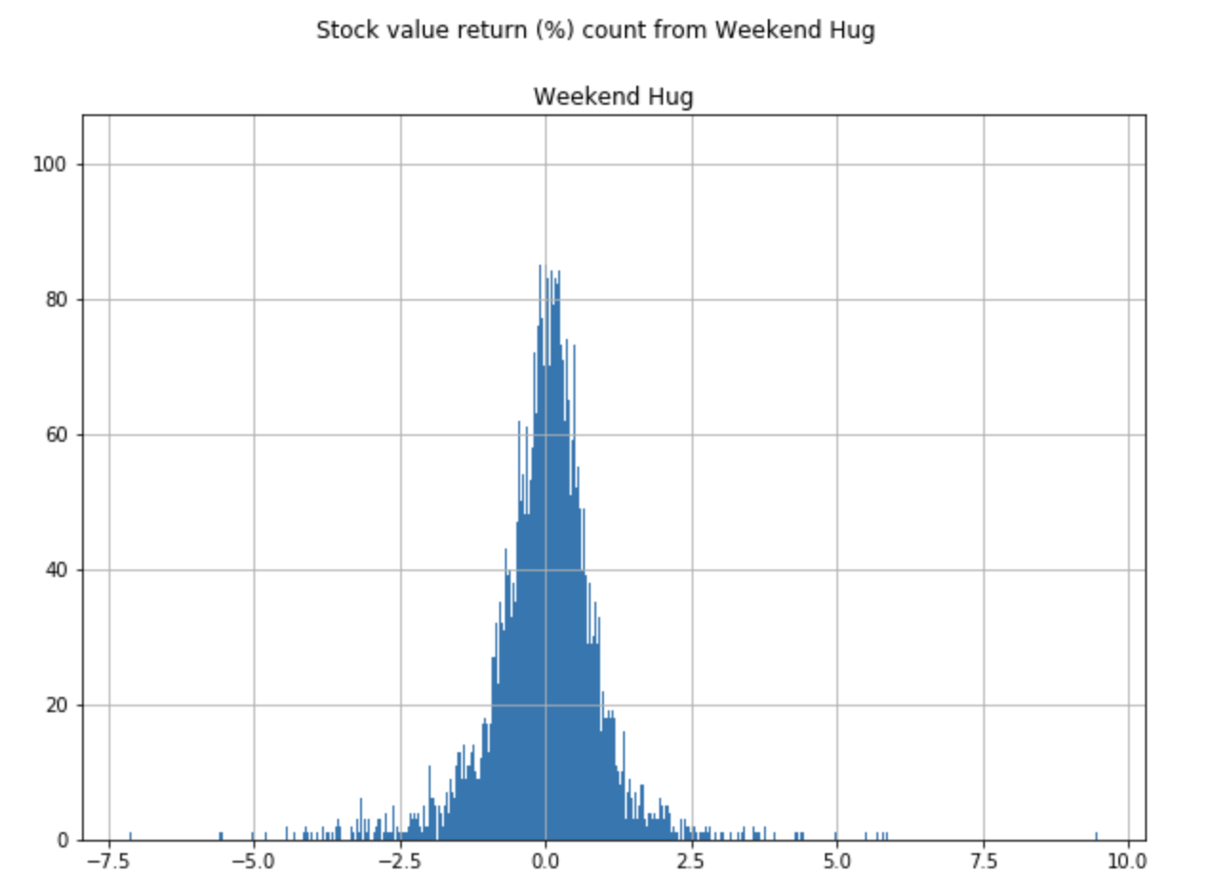
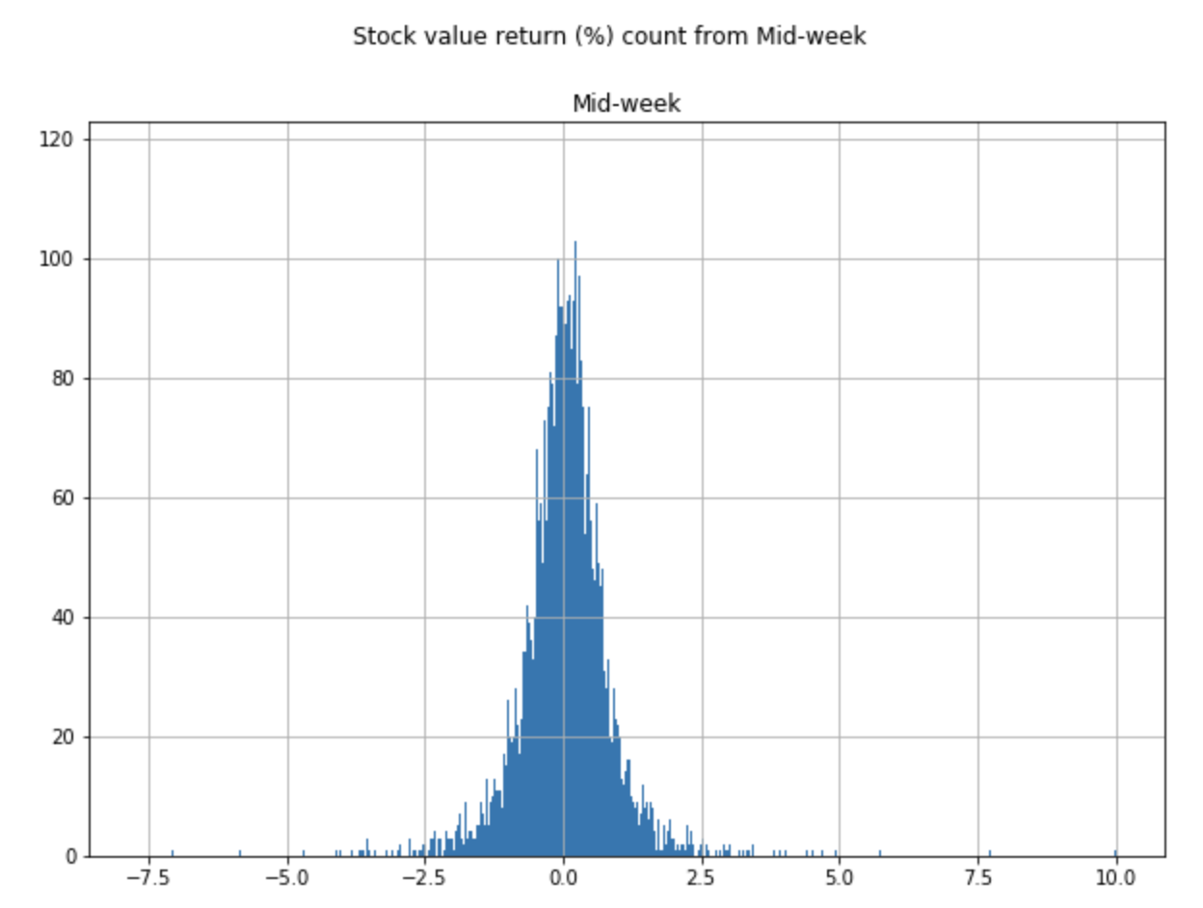
average % returns distribution
Both the Mid-Week (left) and Weekend Hug (right) appear be normally distributed.
Skewness was verified to be between -0.5 and +0.5 signaling near-normal distribution.
The 2-Sample t-test was an appropriate test to statistically compare the samples.

Slide 17
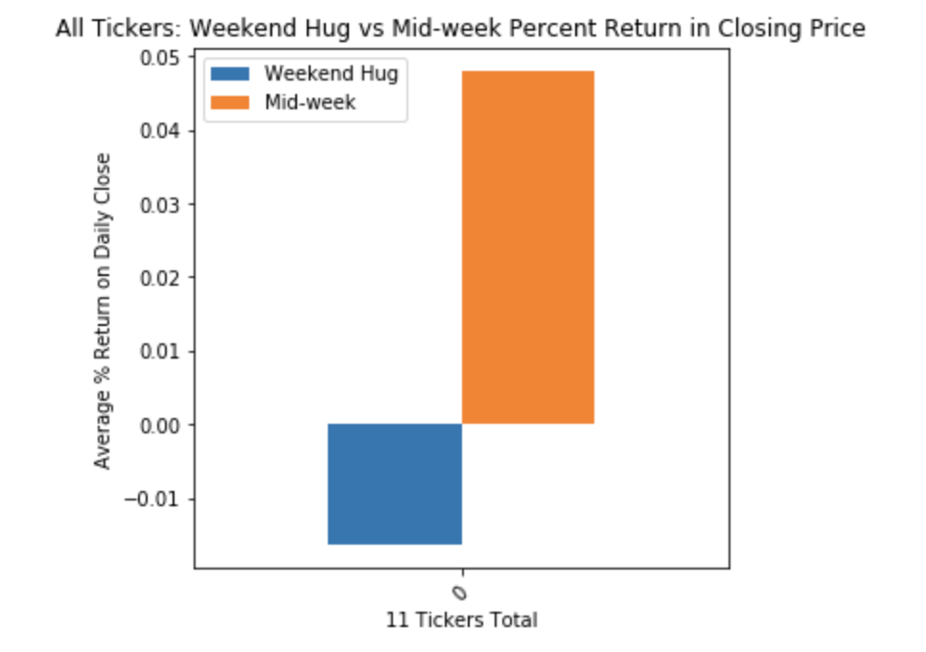
Tickers As a group: Mid-week vs. Weekend hugs
Average % returns are significantly higher for Mid-Week over Weekend Hug.
4.8%
T-statistic=-4.39
p-value=0.00001
Significantly different at 0.05 level
-1.6%

Slide 18
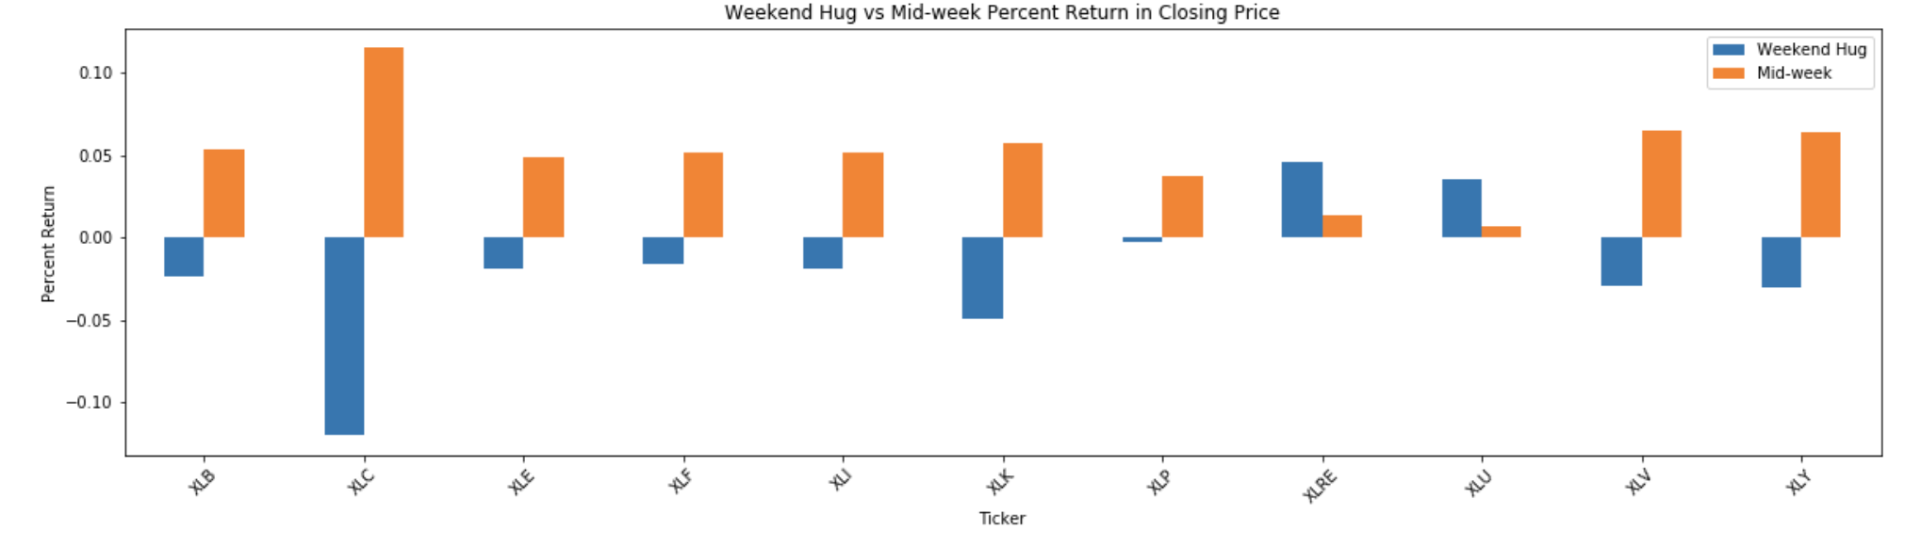
Average % returns by ticker
Only two tickers have higher average % returns for Weekend Hug over Mid-Week.
Differences in holding periods are only significant for Technology, Healthcare, & Consumer Discretionary sectors.
Red = significantly different at 0.05 level
Materials Sector
Telecomm. Svcs Sector
Energy Sector
Financial Sector
Industrials Sector
Technology Sector
Consumer Staples Sector
Real Estate Sector
Utilities Sector
Healthcare Sector
Consumer Discretionary Sector
t-statistic 1.56
p-value=0.12
t-statistic 1.28
p-value=0.20
t-statistic 1.24
p-value=0.21
t-statistic 1.18
p-value=0.24
t-statistic 1.66
p-value=0.10
t-statistic 2.16
p-value=0.03
t-statistic 1.40
p-value=0.16
t-statistic -0.44
p-value=0.66
t-statistic -.79
p-value=0.42
t-statistic 2.67
p-value=0.007
t-statistic 2.16
p-value=0.03

Slide 19
Conclusions

Slide 20
Hypothesis #1 – S&P sectors AS A GROUP
Hypothesis #1: Considering the 11 S&P sectors as a group, buying Monday’s close and selling on Thursday’s close (Mid-Week) achieves a 0.25% higher average return than buying Thursday’s close and selling on Monday’s close (Weekend Hug).
Null Hypothesis (Ho): There is no relationship between average returns and buying and selling over these two periods of interest from 1/3/2000 through 7/19/2019.
Conclusion: We reject the null hypothesis because the p value is 1.16e-05 which is less than the 0.05 significance level. The relationship between the holding period and average % returns is not random for S&P sectors when considered as a group. Mid-Week average % returns are significantly higher than Weekend Hug at positive 4.8% vs. negative 1.6% respectively.

Slide 21
Hypothesis #2 – S&P sectors individual tickers
Hypothesis #2: Considering the 11 S&P sectors individually, buying Monday’s close and selling on Thursday’s close (Mid-Week) achieves a 0.25% higher average return than buying Thursday’s close and selling on Monday’s close (Weekend Hug).
Null Hypothesis (Ho): There is no relationship between average returns and buying and selling over these two periods of interest from 1/3/2000 through 7/19/2019.
Conclusion: We fail to reject the null hypothesis. The relationship between the holding period and average % returns appears random for S&P sectors when considered as individual tickers. Only 3 of 11 sectors show significantly different average % returns.

Slide 22
Implications of findings
Possible Causation for Mid-Week Performing Better
Tuesday’s Returns
Traders Fear the Weekend News Cycle
Traders Want to Enjoy the Weekend
Potentially buy One S&P 500 ETF for Mid-Week Holding Period
Past Performance NOT Indicative of Future Results

Slide 23
Questions? Thank you!

